Slide 1

PACK-MAN DELIVERY
SHIPPING & LOGISTICS HUB
A full Stack web application for an Enterprise providing shipping services
Ashwin Raj - A
Prashant Bhutani - A20488431

Slide 2
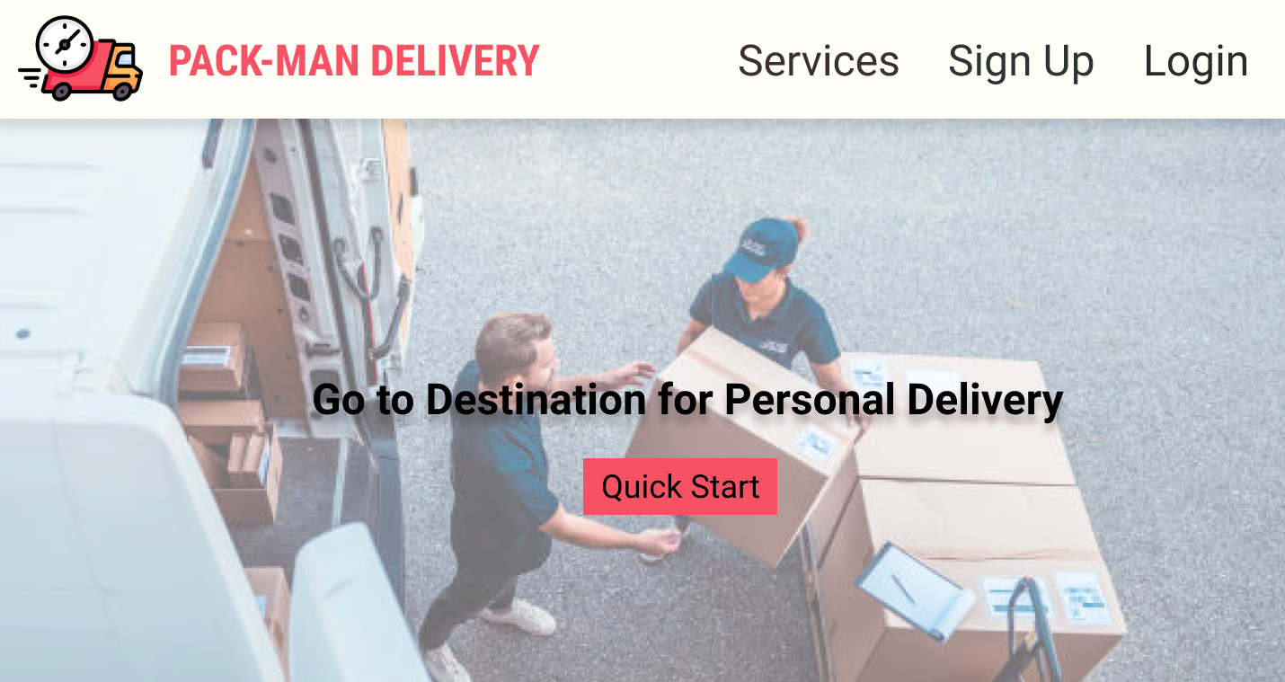
HOMEPAGE
About

Slide 3
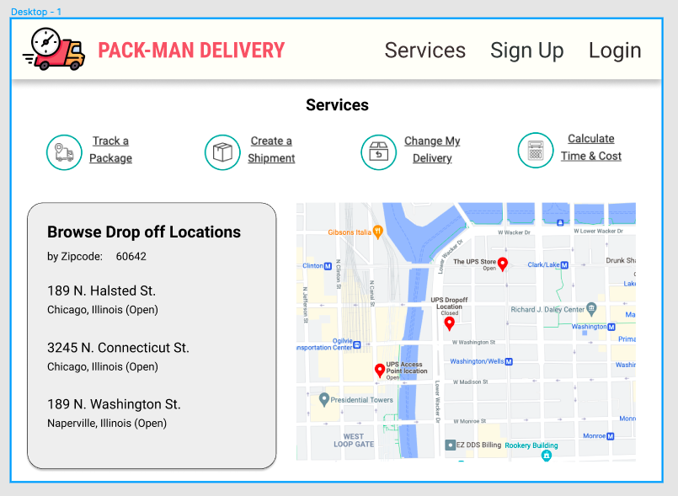
Services as Features
Ship packages
Track Pakages
Find Nearest Shipping Hub
Time & Cost Calculator
Delivery Scheduler

Slide 4
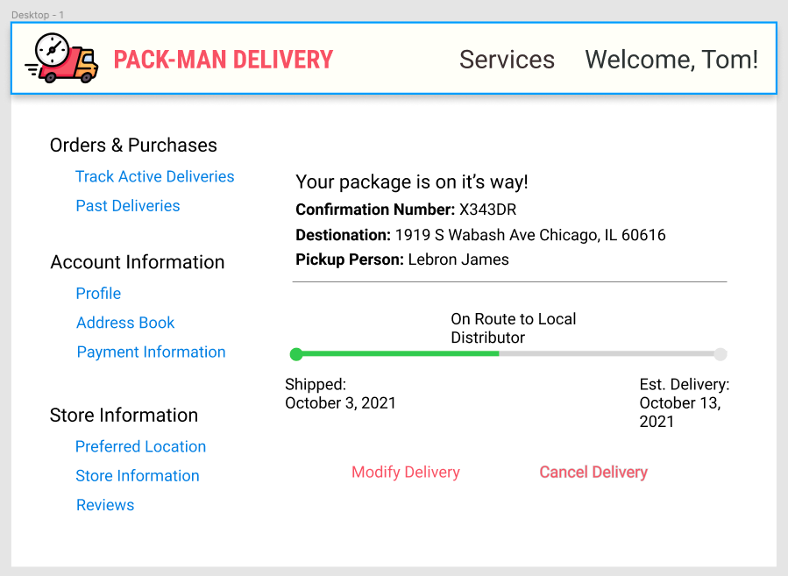
Customer Profile View
Orders Tracking Dashboard
Modify Current Shipment
Orders & Purchases
Account Information
Store Information

Slide 5
Technology Stack
Nodejs
Server with
Express
middleware
React &
Redux
HTTPS
AJAX
JSON
REST APIs
Databases
SQL, NoSQL, Graph
Open Source Packages (NPM)
AWS
EC2/ECS
Docker
Open Source
Highly Available
Extensible
Modular and Scalable

Slide 6




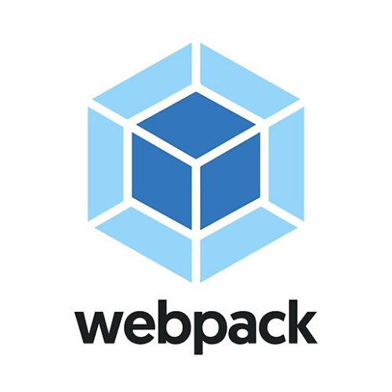




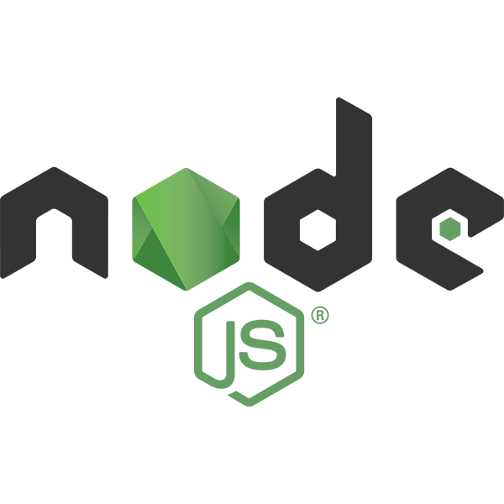

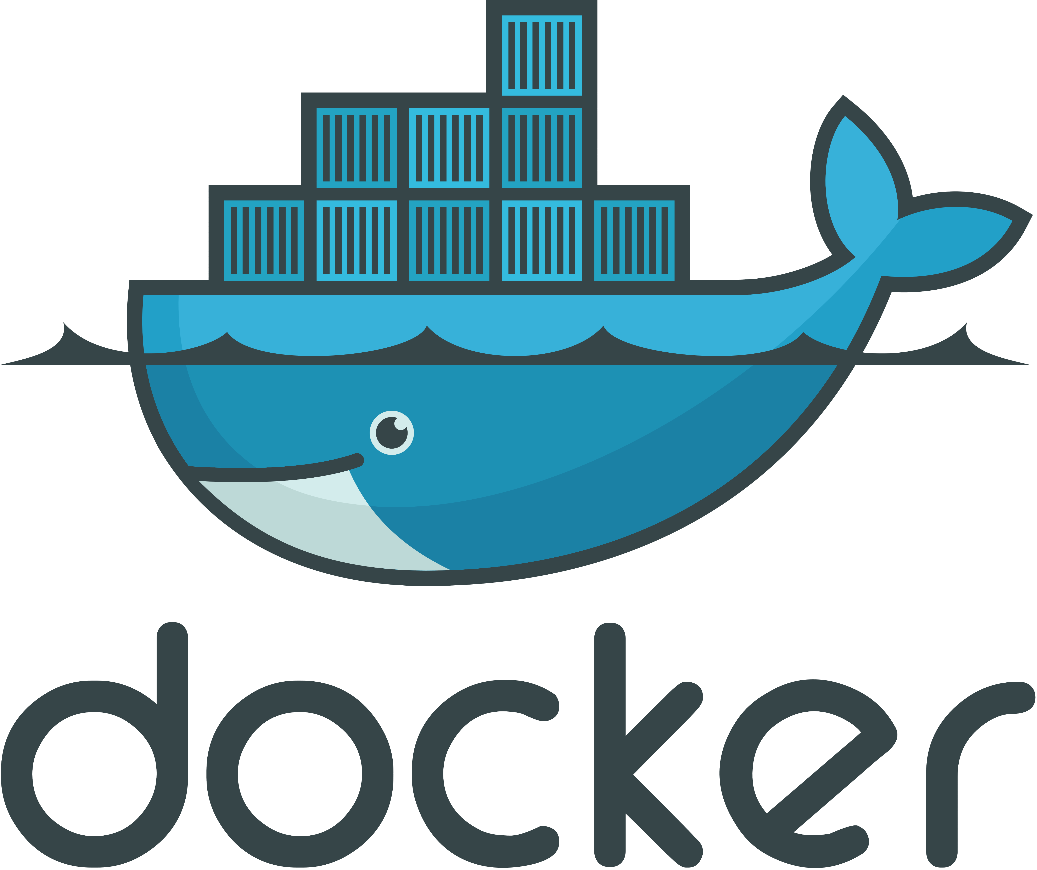











Application Architecture
Component based UI
Nodejs Server
NPM
REST APIs

